Slide 1
CSE 4204
KUET CAFETERIA
PRESENTED BY,
SIMON WALTER TUDU
ROLL : 1807121

Slide 2
Control
0 => Rotate Fan
2 => Turn On and off Point Light
1 => Turn On and off Directional Light
3 => Turn On and off Spot Light
I => Robot Move Forward
J => Robot Move Left
K => Robot Move Backward
L => Robot Move Right
W => Camera Move Forward
A => Camera Move Left
S => Camera Move Backward
D => Camera Move Right
E => Camera Move Up
R => Camera Move Down
F => Door Open and Close

Slide 3
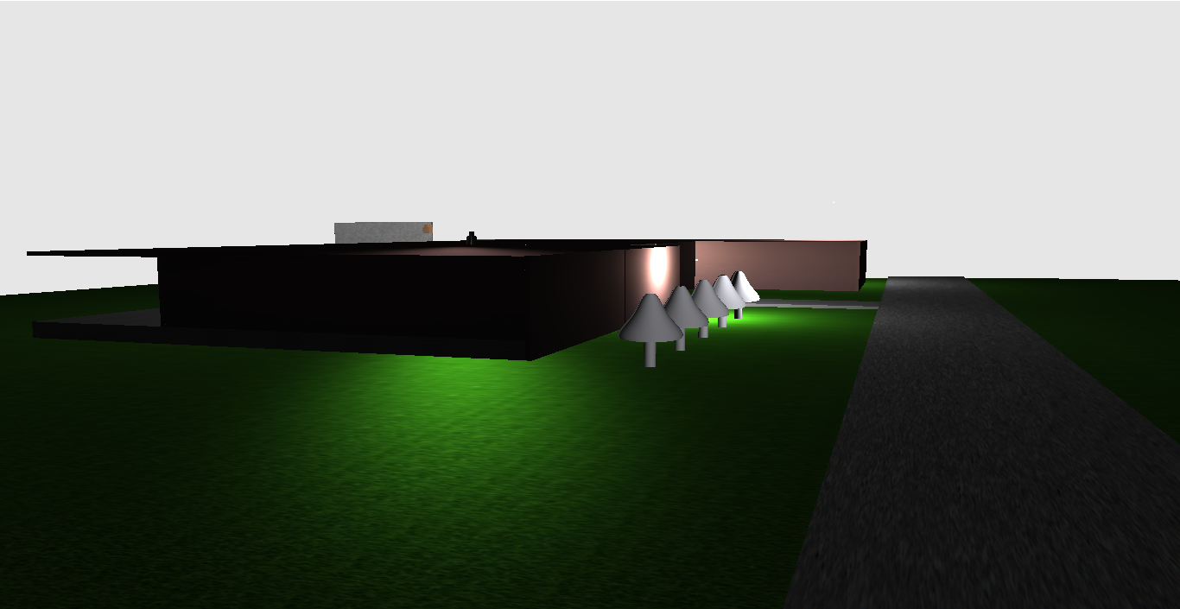
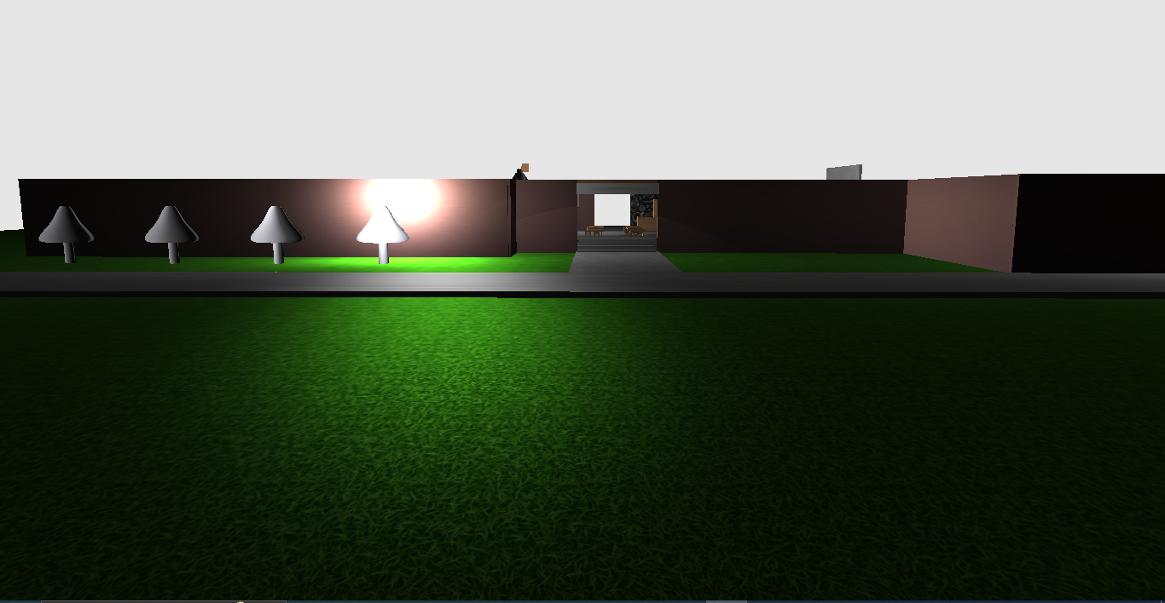
Outside View
Fig 1: Outside view 1
Fig 2: Outside view 2

Slide 4
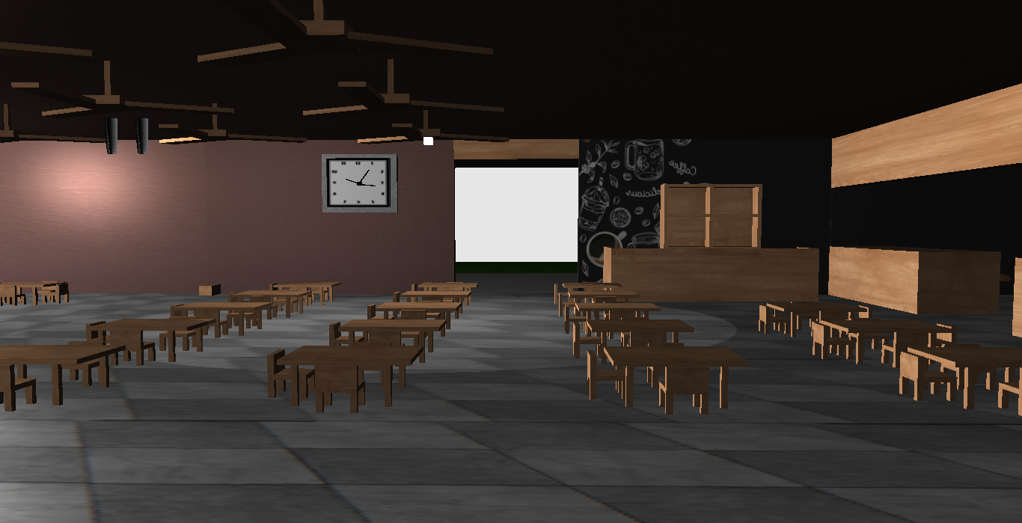
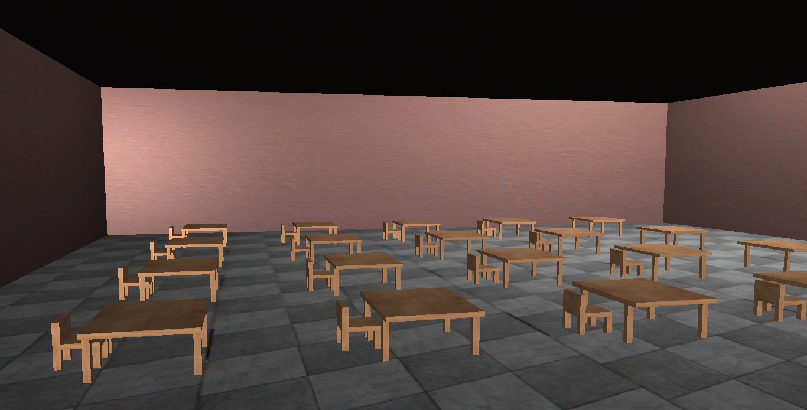
Inside View
Fig 3: Inside view 1
Fig 4: Inside view 2

Slide 5
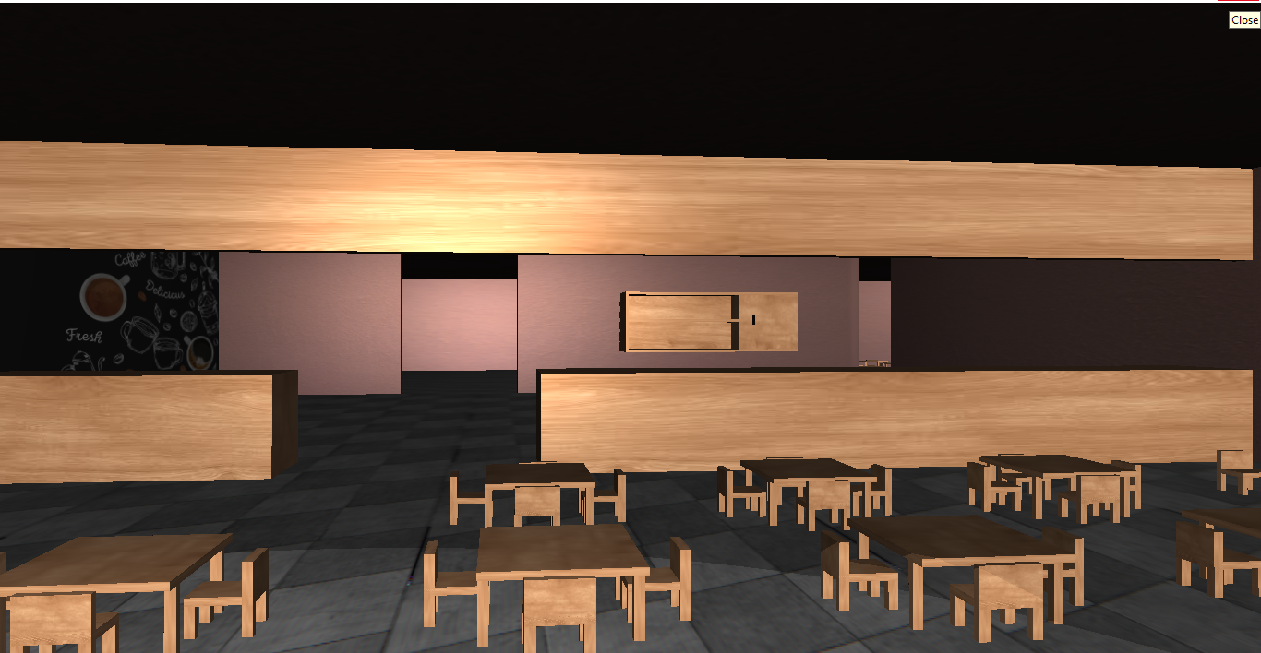
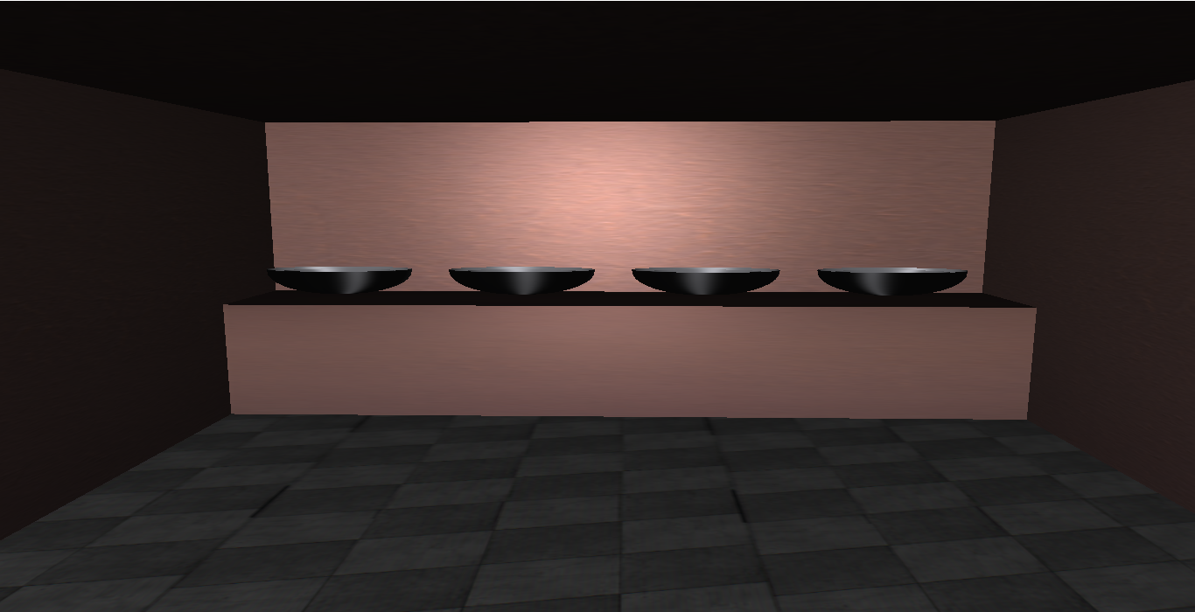
Serve Area and Wash Room
Fig 5 : Serve area view
Fig 6 : Washroom view

Slide 6
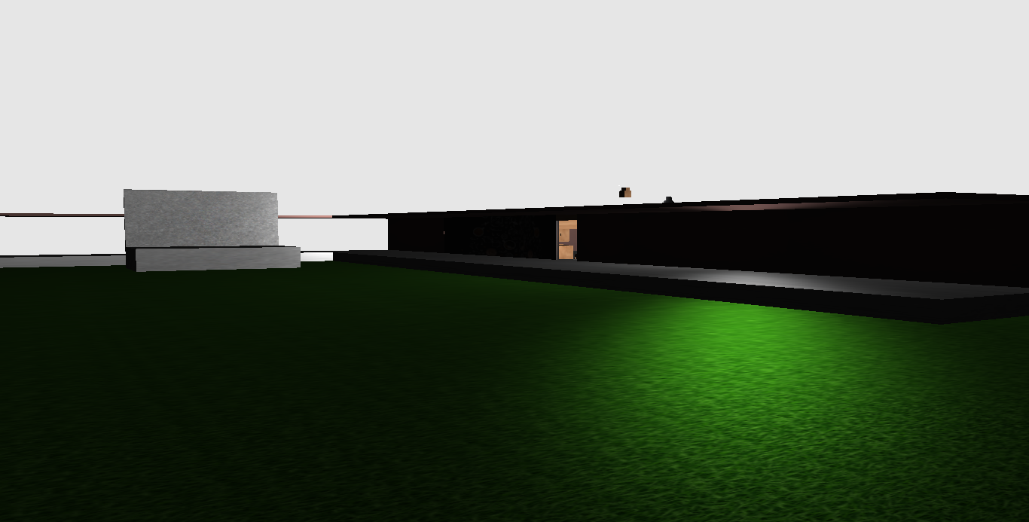
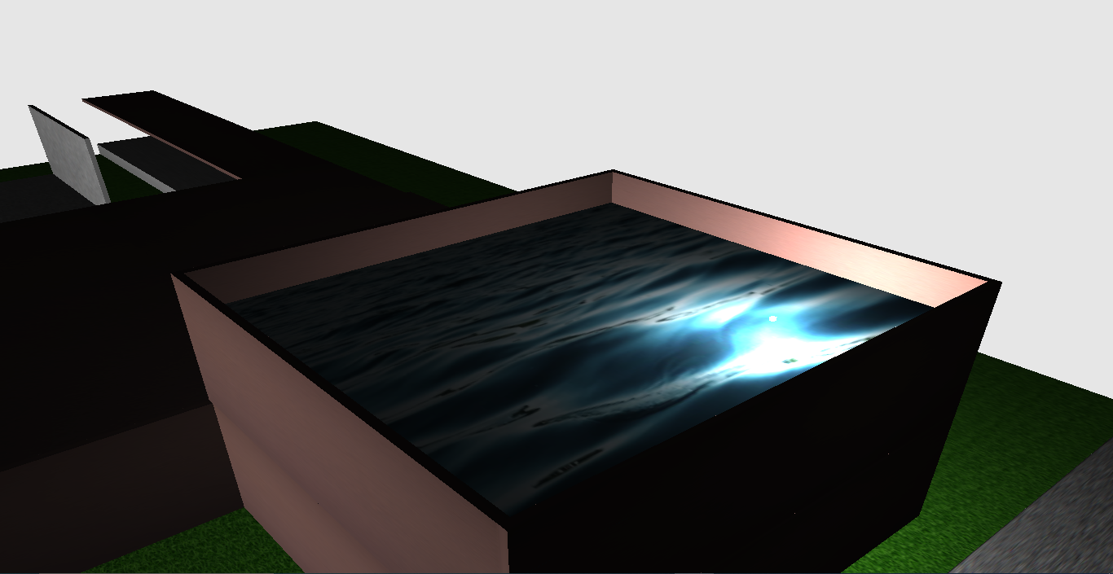
Mukto Moncho and Swimming Pool
Fig 7 : Mukto Moncho
Fig 8 : Swimming pool

Slide 7
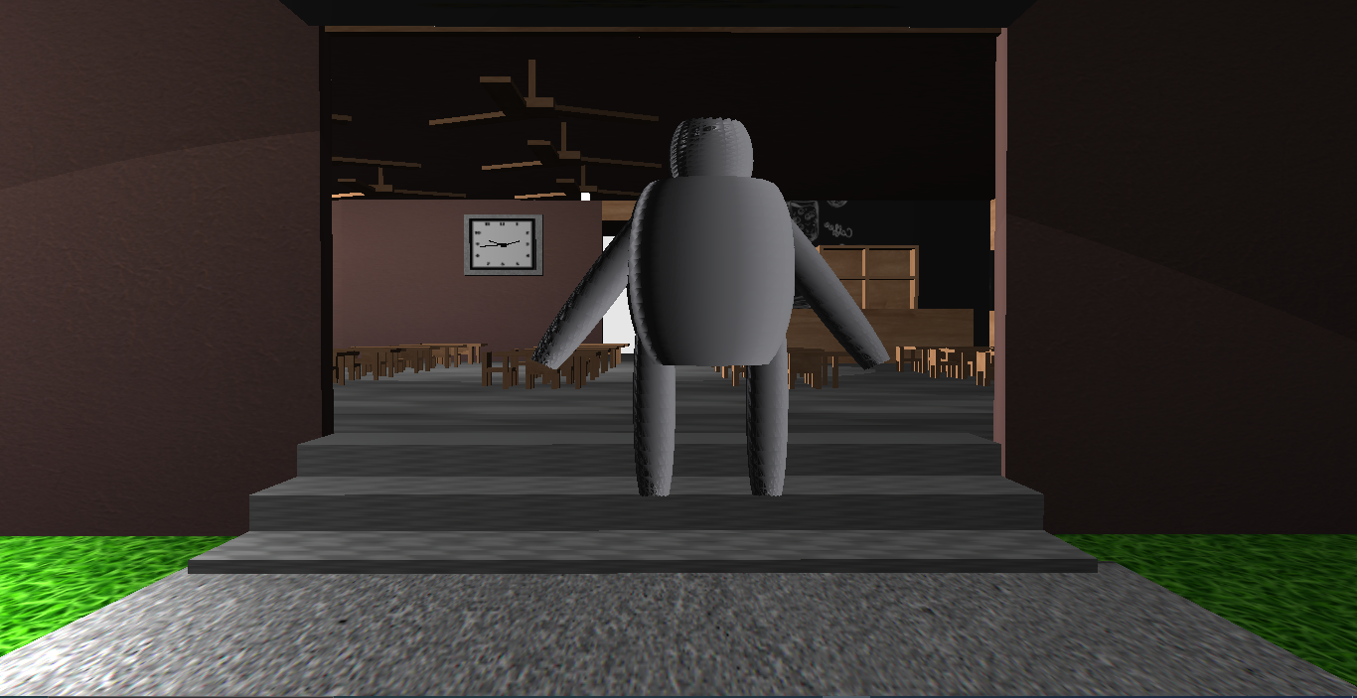
MY Robot
Fig 9 : My robot

Slide 8
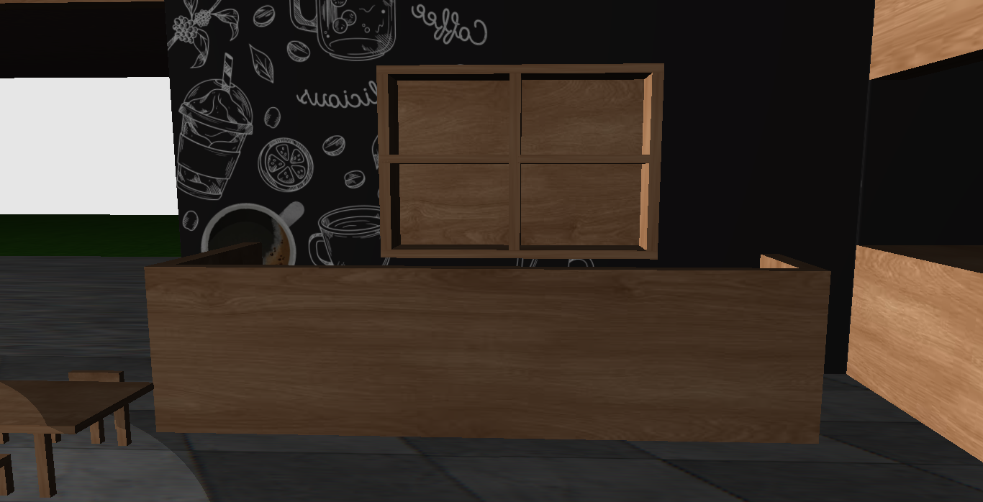
Counter
Fig 10 : Counter

Slide 9
Thank You

